Slide 1
Network Security Architecture
CYBR 515
By
Daniel Carbajal

Slide 2
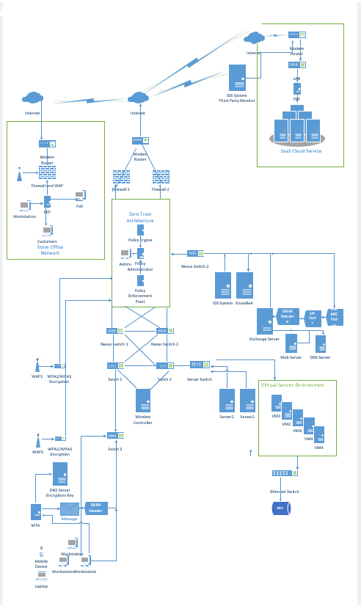
Overview of New Network
Based on case study:
Provide the most updated type of security
Add in Web and DNS Servers
Needed to add protection to servers
Secure email and login
Add in a SaaS cloud system
Protect the Store data back to the main network
Notes:
Here is a representation of the New Network topology. The overall system will be designed behind a Zero Trust Network. Some of the servers have been moved behind the firewall. And have added servers to authenticate incoming email and data traffic. Have insured data is processed through a firewall. And it will interface with a SaaS cloud system that will be secured. The remote store will be designed to be under the Zero Trust and Firewall protection as well.

Slide 3
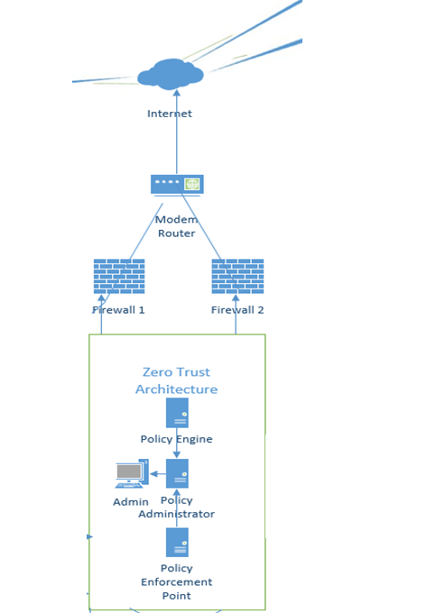
Zero – Trust Network
The network will be based on Zero Trust Network
From “Trust but Verify” to “Don’t Trust and Verify Everyone
Basic Setup
Policy Engine
Policy Administrator
Policy Enforcements Point
Policy will be based on Zero-Trust techniques
Notes:
Zero Trust network is a protocol based on the principle of authenticating everyone that needs to access the system. No one is authorized the system until they have been verified. This will include having firewalls that only let data traffic through. Then the Zero Trust Architecture will consist of multi-level authentication, endpoint monitoring and threat detection. User access will spread to the entirety of the system to include the Cloud and the Store Network front. The zero-trust policy will extend through all the networks including remote sites and users. Constant monitoring will be done include endpoint monitoring to ensure all systems are not being attacked or doing something that is not authorized. The will be a police engine that grants authority to users allowed in the network. The policy administrator is there to establish the communication path and shut down the connection between the user and the resource being used. The policy enforcement unit monitors and establishes and terminates the connections between the paths. Overall, this will provide a greater amount of security to the overall system network. These protections will extend throughout the entire network including remote sites and employees.

Slide 4
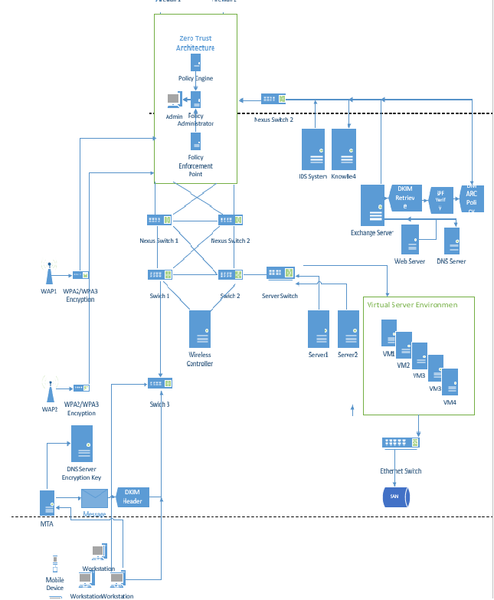
Main Network
Firewalls and Encryption will be set on Wireless Access Points
Will have Least Privilege access
Will have DMARC email security
The overall network will be segmented as deemed necessary
Will have access to SaaS cloud and Store front if authorized to do so
The Virtual Server network will only be accessed by authorized personnel
Notes:
The main network will house all the network equipment as well as provide network resource access to pertinent employees. All inputs will have firewall security and this feature will also be turned on in the Wireless Access Points. Then it will be constantly monitored and accessed through the Zero Trust system. Login will include multifactor authentication and email and SMS messages will be encrypted, and the email will also have a DMARC security encryption for a higher level of security. This will help protect against email spoofing and other attacks. Only authorized users will be allowed to certain areas such as the store network, the Cloud System, and the virtual server network. From security policy standpoint the areas will be segmented based on who is authorized to use resources The system will also have some redundancy in case of system failure.

Slide 5
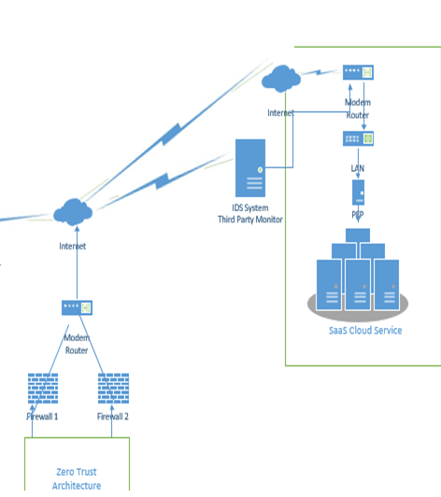
SaaS Cloud Model
SaaS cloud Model for software
Financial software used by employees
Constant Monitoring of Cloud
Included in the Zero-Trust security
Protection by provider
Can select security measures
Only authorized employees will have access
Notes:
The SasS will be used by the staff by using the storage to save corporate documents and sales information, including credit card information. The SaaS is a third-party solution which has been widely used and vetted by other organizations to be effective and secure. SaaS saves the software installation, maintenance, upgrades, and patches. The Cloud Provider will provide the security updates and patches needed over time. This will reduce costs to the customer and to the organization as well as the time of having to monitor the data. A third-party IDS will also be used to monitor the connection and try to mitigate any possible attacks to the interface.
In order to ensure network security, we will turn on some additional settings that provider provides to include the following:
• Identity and access management
• Data loss prevention
• Web security
• Security assessments
• Intrusion Management
• Encryption

Slide 6
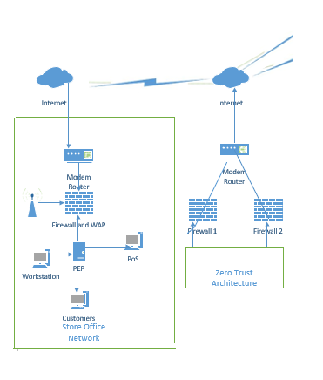
Store Front Network
The network will be based on Zero Trust Network
Firewall access at inputs
Same level of network encryption
PEP standard so that network is seen as part of the network security structure
Same authentication methods as Main network
Notes:
The store network will also have the same security policies as the Zero-Trust design will extend to this network. This will include firewall support, network encryption, and access to only areas that a user is authorized for.
The same authentication method will be used, and it will be branch of the network as opposed to the remote network. The network will be monitored on a 24/7 basis as opposed to only working hours. And information will flow to the main network first and then to the Cloud Service Provider.

Slide 7
Conclusion
The network will be based on Zero Trust Network
Main Network, SaaS, and Store Front will be part of Zero-Trust Policy
Encryption of email and SMS messaging
Multi-factor authentication for everyone
Up to date with most recent security standards as possible.
Notes:
So overall, the network system will be based on a Zero-Trust policy. This will include the entire network including remote sites and personnel. Encryption and DMARC will be used accordingly for email and SMS messaging and multi-factor authentication for all access to the network. With the right security policies and equipment, the organizations resources and personnel will be secured. This includes Zero-Trust implementation and constant 24/7 monitoring.

Slide 8
References
Stallings, W. (2017). Network Security Essentials: Applications and standards (6th ed.). Pearson Education.
U.S. Department of Defense. (2021). Embracing a Zero Trust Security Model. Retrieved August 2, 2022,

